Slide 1

HOME SECURITY SYSTEM USING RASPBERRY PI
BASED MINOR PROJECT ON
AN
GUIDED BY:
Mr. S. VISHNU
ASSISTANT PROFESSOR
VFSTR
PRESENTED BY:
E. SHARAN 181FA05087
K. TANUJA 181FA05222
M. HARI KRISHNA 181FA05225

Slide 2
CONTENTS
c
Purpose and Requirements
01
c
Project Apparatus
02
c
Home Security System
03
c
Sensors
04
c
Computing Device
05
c
Application
06
c
Circuit Diagram & IoT Level Specification
07
c
Procedure
08
c
Implementation & Result
09
c
Advantages, Disadvantages & Applications
10
c

Slide 3
PURPOSE & REQUIRMENTS
PURPOSE
The purpose of Home Security System Using Raspberry Pie is to detect intrusions using sensors and raise alerts, if necessary.
BEHAVIOUR
In case of any intrusion, user intend to capture a picture of the intruder, mail the image to the respective end users and alert them.
This project also has alarm alert system which activates in case of an intrusion.

Slide 4
System Management Requirement
The system should provide remote monitoring and control functions.
Data Analysis Requirement
The system should perform local analysis of data detected by LDR & PIR.
Application Development Requirement
The application should be developed locally on the device and remotely accessible.
Security Requirement
The system should have basic user authentication capability.

Slide 5
PROJECT APPARATUS
Home Security System
Node Red Application
Raspberry Pi 3
PIR Sensor
USB camera
LDR
Buzzer & LED
Laser Pointer
Connecting wires

Slide 6
HOME SECURITY SYSTEM
Home Security System Using Raspberry Pie is to detect intrusions using sensors and raise alerts, if necessary.
Intrusion is detected by LDR & PIR
In case of any intrusion, user intend to capture a picture of the intruder, mail the image to the respective end users and alert them.
Home Security System also has alarm alert system which activates surroundings in case of an intrusion.

Slide 7
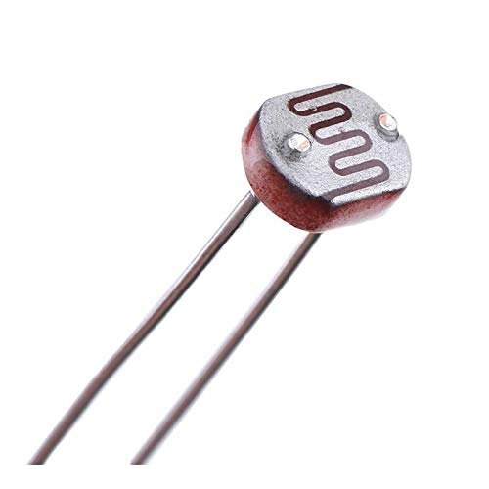
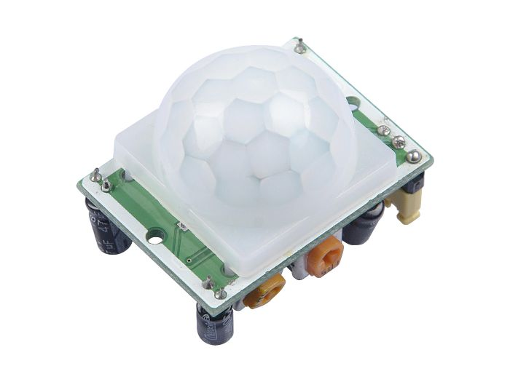
SENSORS
LDR:
A Photoresistor is a passive component.
The resistance of a photoresistor decreases with increase in incident light intensity.
It exhibits photoconductivity.
In the dark, a photoresistor can have a resistance as high (Megaohms (MΩ)), while in the light, a photoresistor can have a low resistance (Hundred ohms).
PIR:
Passive Infrared Rays Sensors is an electronic sensor that measures IR from objects in its field of view.
These are generally used as motion detectors and applied in security alarms & automatic light applications
When motion was detected by the receiver of the sensor module it produces HIGH voltage output else LOW voltage

Slide 8
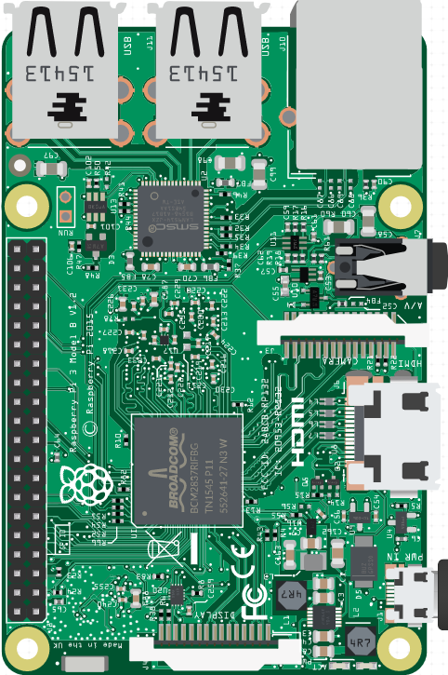
COMPUTING DEVICE
RASPBERRY PI 3
Raspberry Pi is a series of small single – board computer developed in the united Kingdom by Raspberry Pi Foundation.
Generally Raspberry Pi works with a Light weight OS called Raspbian OS.
In this project, Raspberry Pi 3 model B with 1GB RAM & 32GB SD card.
GPIO Pins: 40
USB Ports: 4
Ethernet Port: Yes
Wi-Fi: Yes
Bluetooth: Yes
Display Cord: HDMI
Power Cord: USB Type

Slide 9

APPLICATION
NODE – RED APPLICATION
Node – RED is a programming tool for wiring together hardware devices, APIs and online services in new and interesting ways.
It provides a browser-based editor that makes it easy to wire together flows using the wide range of nodes in the palette that can be deployed to its runtime in a single-click.
Node – Red provides
Browser based flow editing
Built on node.js
Social Development
Excellent Dashboard
Numerous Palettes
Runs Locally
Reduces Coding

Slide 10
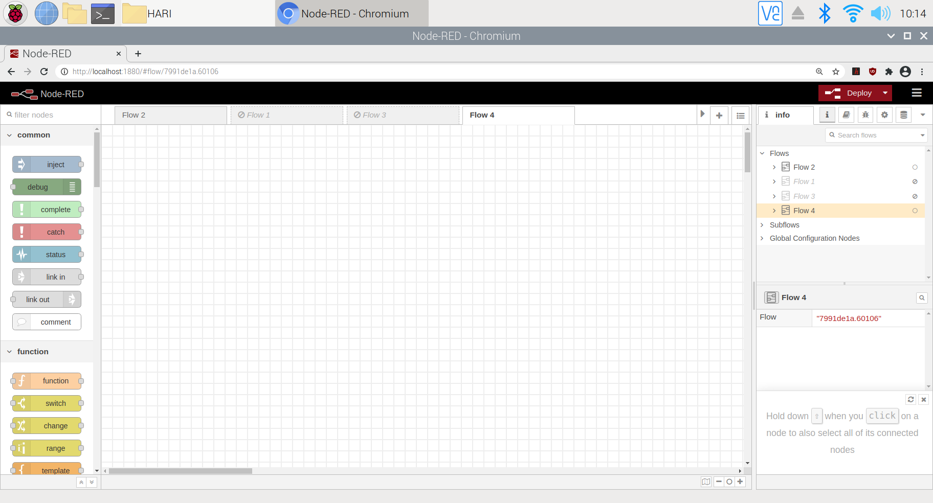
NODE – RED APPLICATION
BASIC LAYOUT
WORKSPACE
Info Palette
Nodes Palette

Slide 11
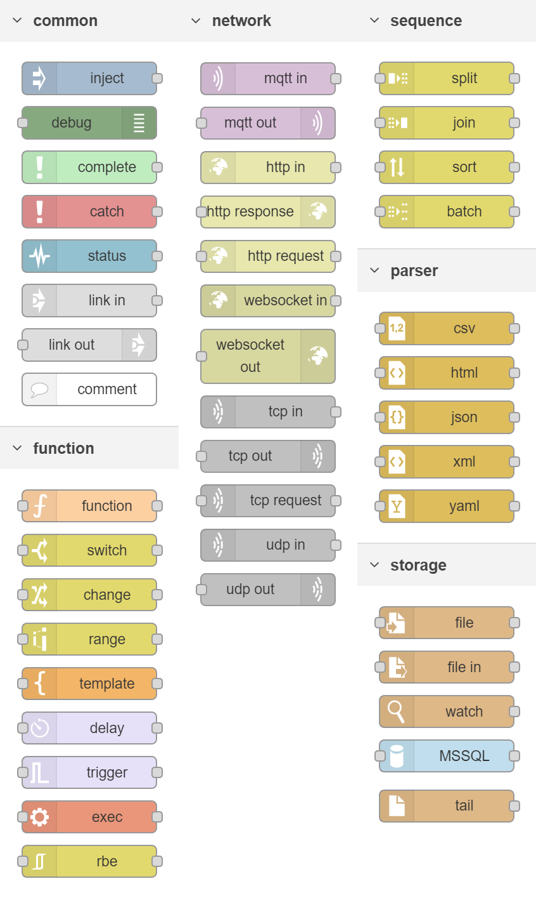
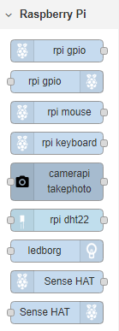
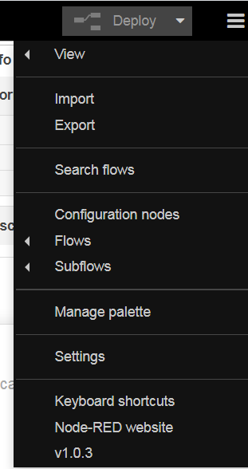
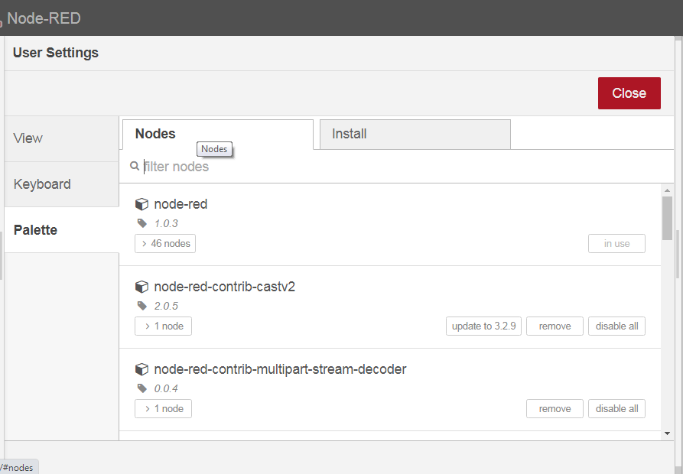
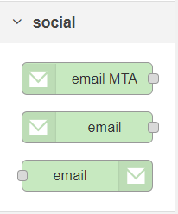
NODE – RED APPLICATION
NODE PALETTE

Slide 12
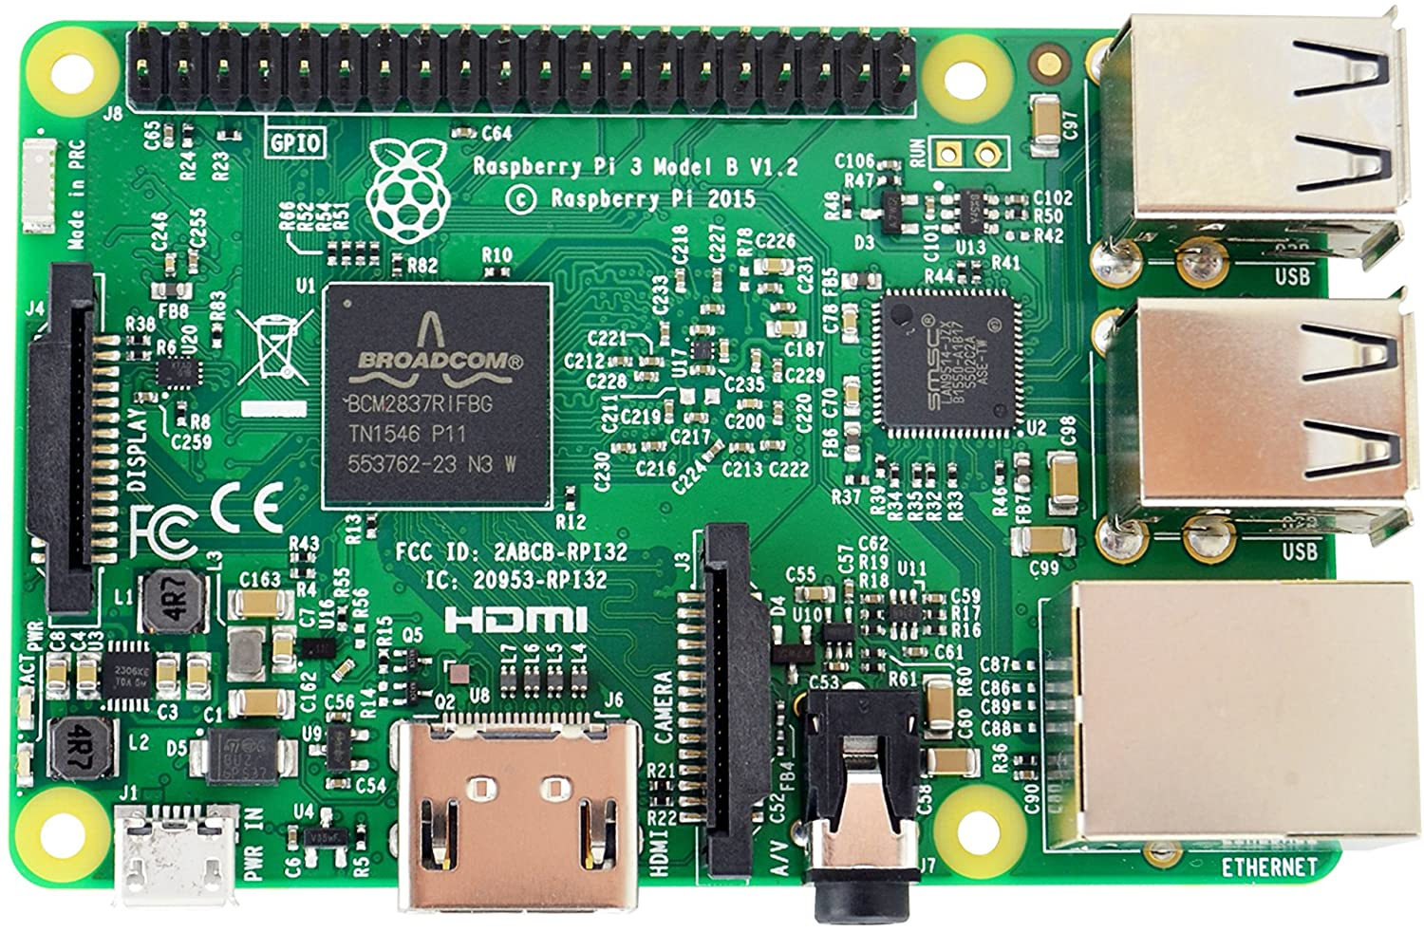
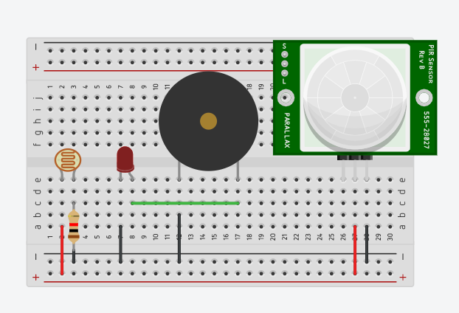
CIRCUIT DIAGRAM
HARDWARE

Slide 13
IOT LEVEL SPECIFICATION
IOT LEVEL 1
LOCAL
CLOUD
Application
REST services
DATABASE
Controller Service
Resource
End Node

Slide 14
PROCEDURE
Condition 1: Process with LDR
The LDR is placed in a room which reads the light level because a Laser light is kept opposite to LDR so that the laser light will always falls on LDR.
Now when the laser beam is breached we can see that there is a gradual fall on light level value. If the light level falls below the threshold value, an image is captured and an alert will be sent to the user and also it turns on the buzzer.
Condition 2: Process with PIR
The PIR motion sensor is placed in a room. It detects the motion in the room.
If there is a motion then an image is captured and an alert will be sent to the user and also it turns on the buzzer.

Slide 15
Condition 1: Check with LDR
Reads values from LDR
LDR Level
Level: HIGH
Level: LOW
Captures the image
Send alert to user
Triggers an alarm

Slide 16
Condition 2: Check with PIR
Reads motion sensor State
Sensor Condition
State: NO
State: YES
Captures the image
Send alert to user
Triggers an alarm

Slide 17
WORKING STEPS
Step 4:
Also, Buzzer & LED are activated in case of any unknown Human / Object detected.
Step 3:
Now, An alert mail is sent to the user with the captured image.
Step 2:
If a motion is detected, I intend to capture the image with the help of webcam and store locally.
Step 1:
With the help of LDR & PIR motion sensor, Motion is detected in the room / respective Area.
Alerting Surroundings
Alerting User
Capturing

Slide 18

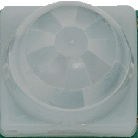
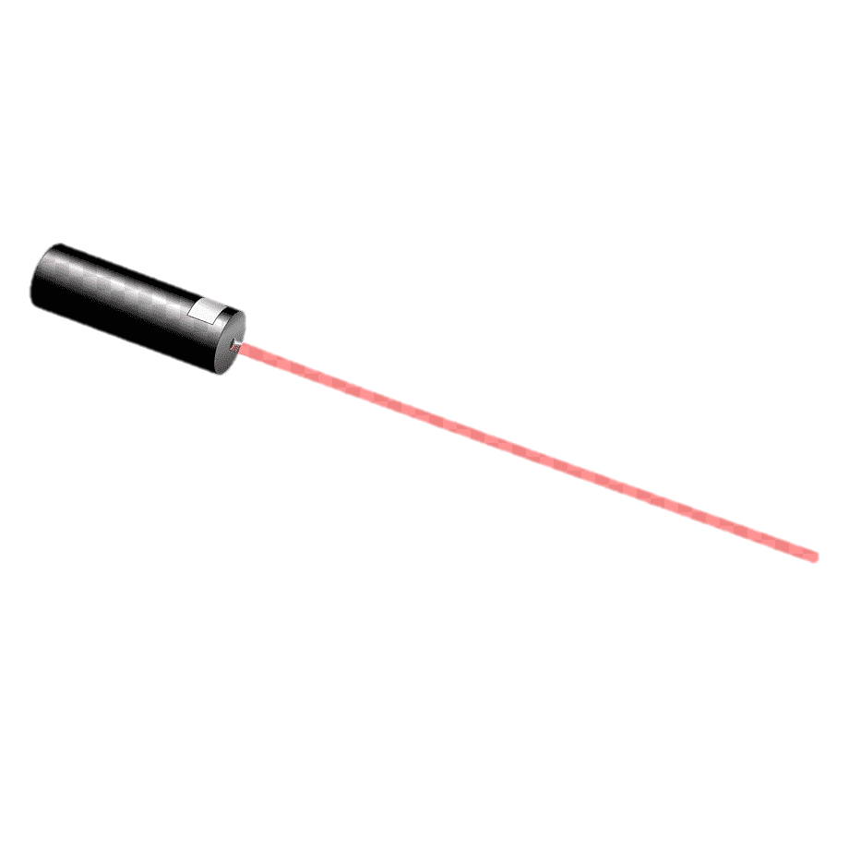
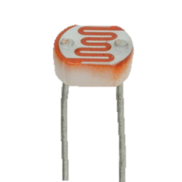
WORKING STAGES
NORMAL STAGE

Slide 19
WORKING STAGES
DETECTION STAGE

Slide 20
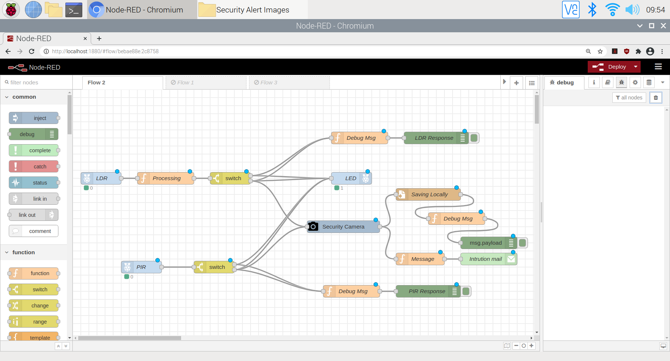
IMPLEMENTATION

Slide 21
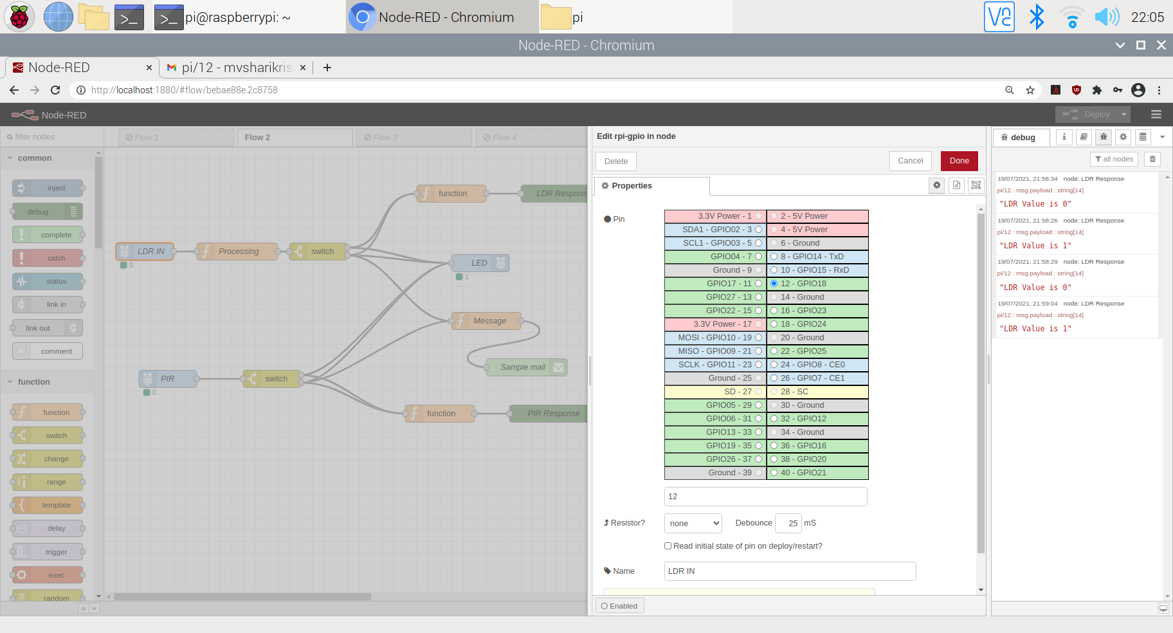
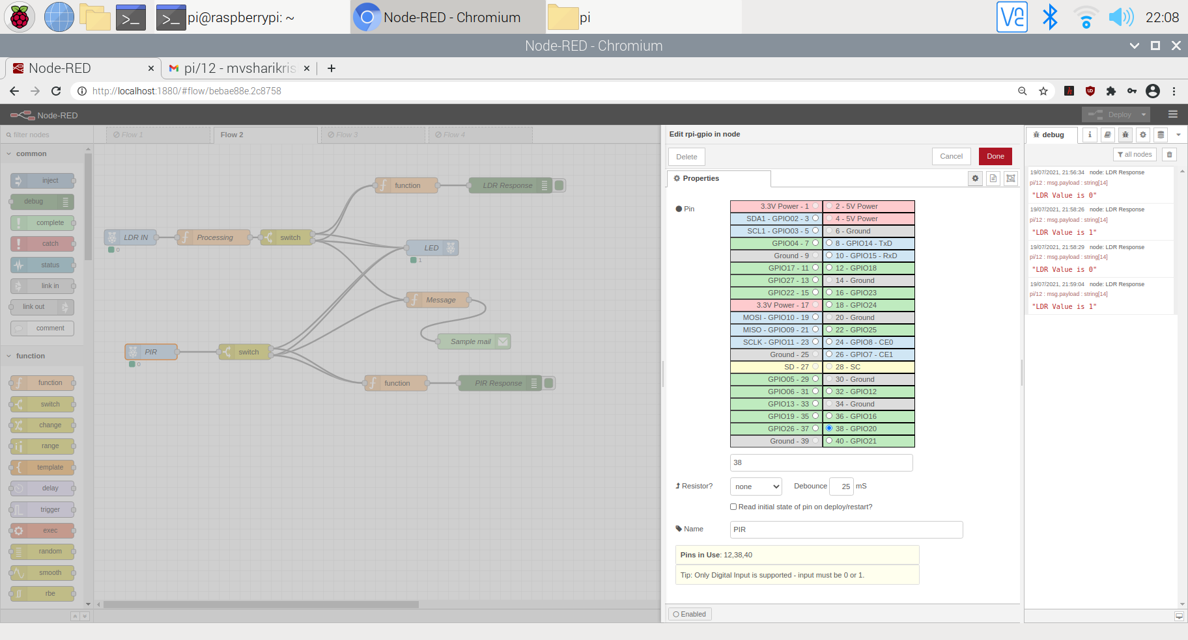
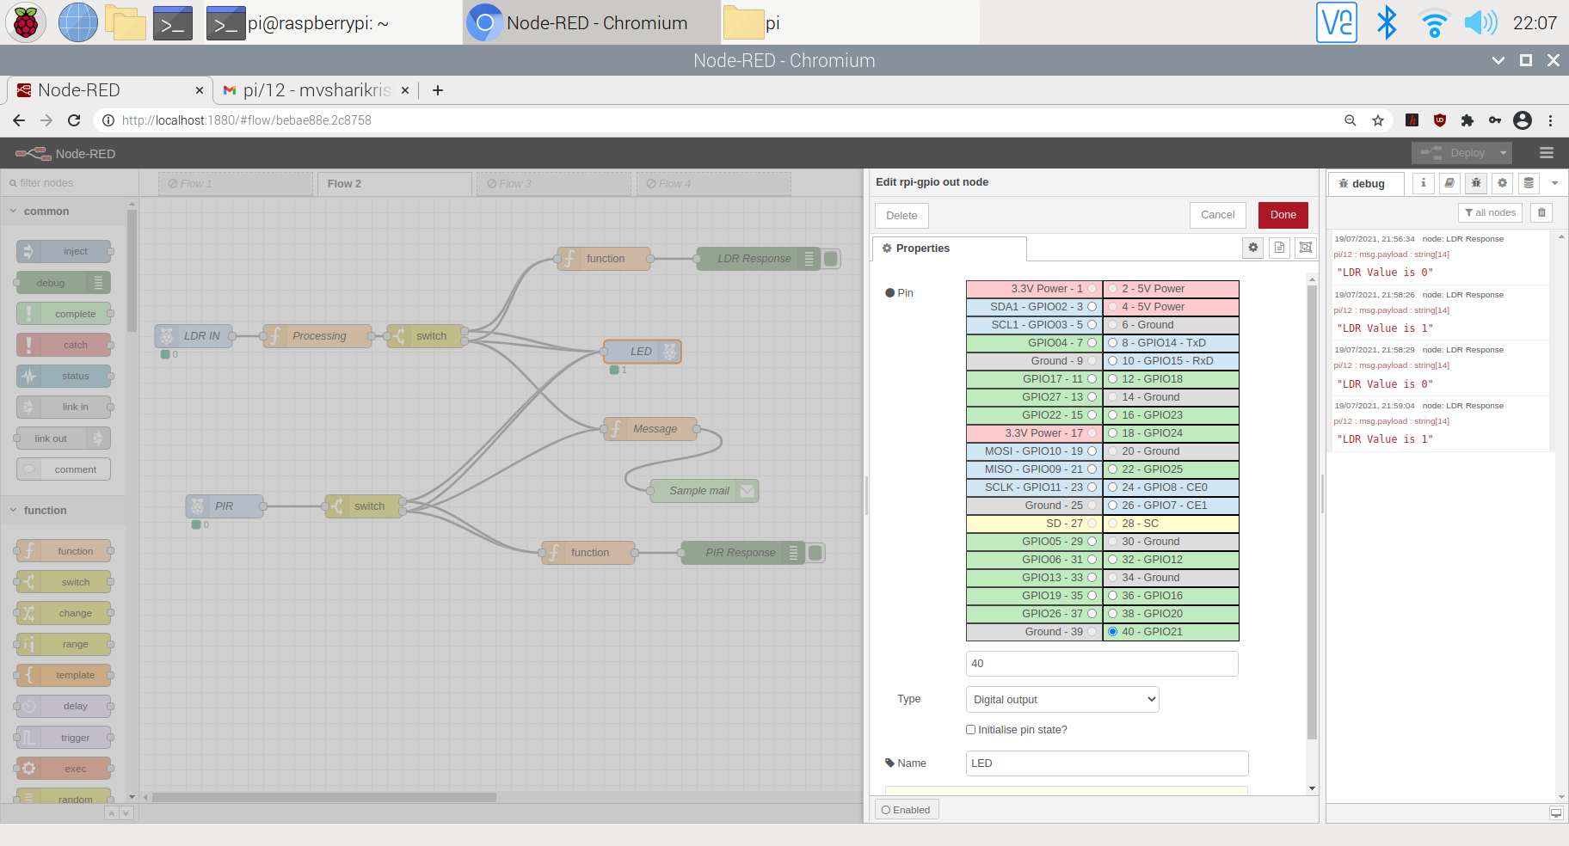
INITIALIZING PINS

Slide 22
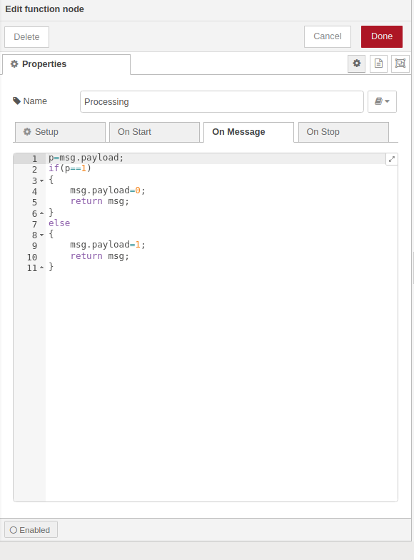
PROCESSING NODE FOR LDR

Slide 23
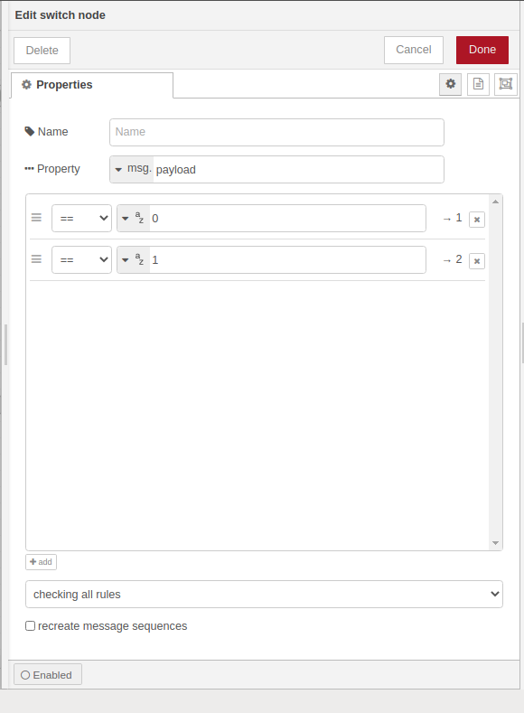
SWITCH NODE

Slide 24
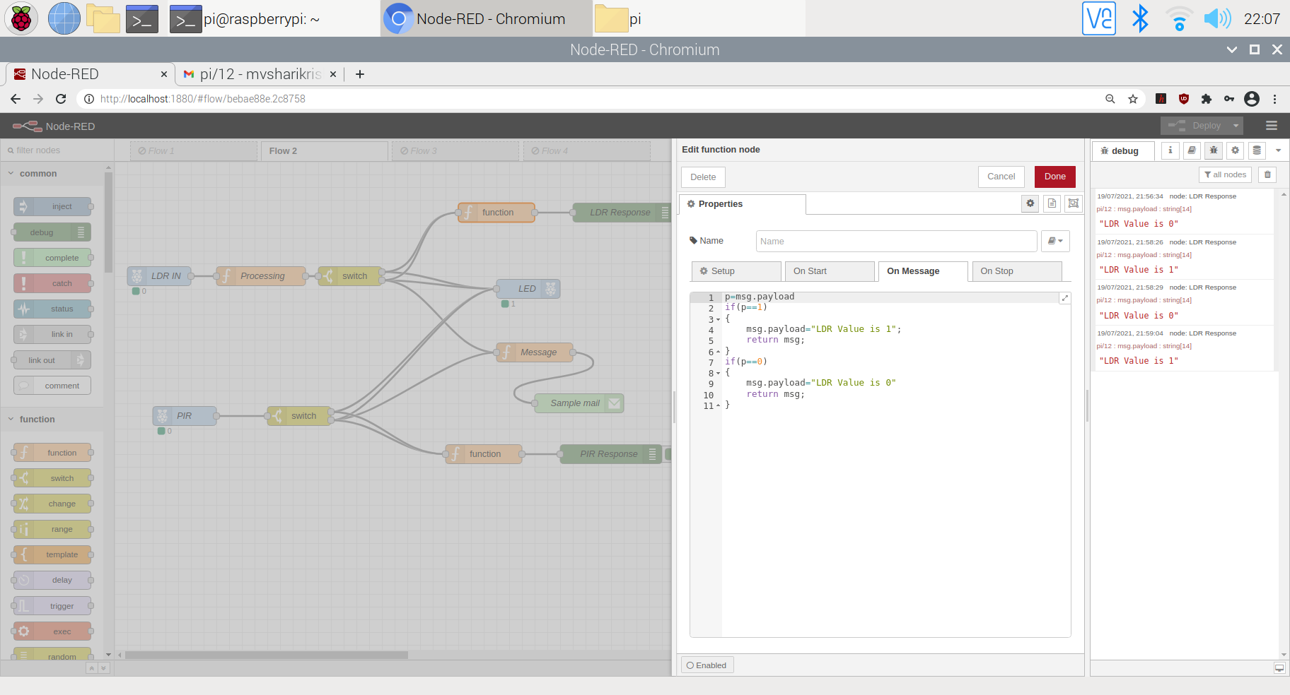
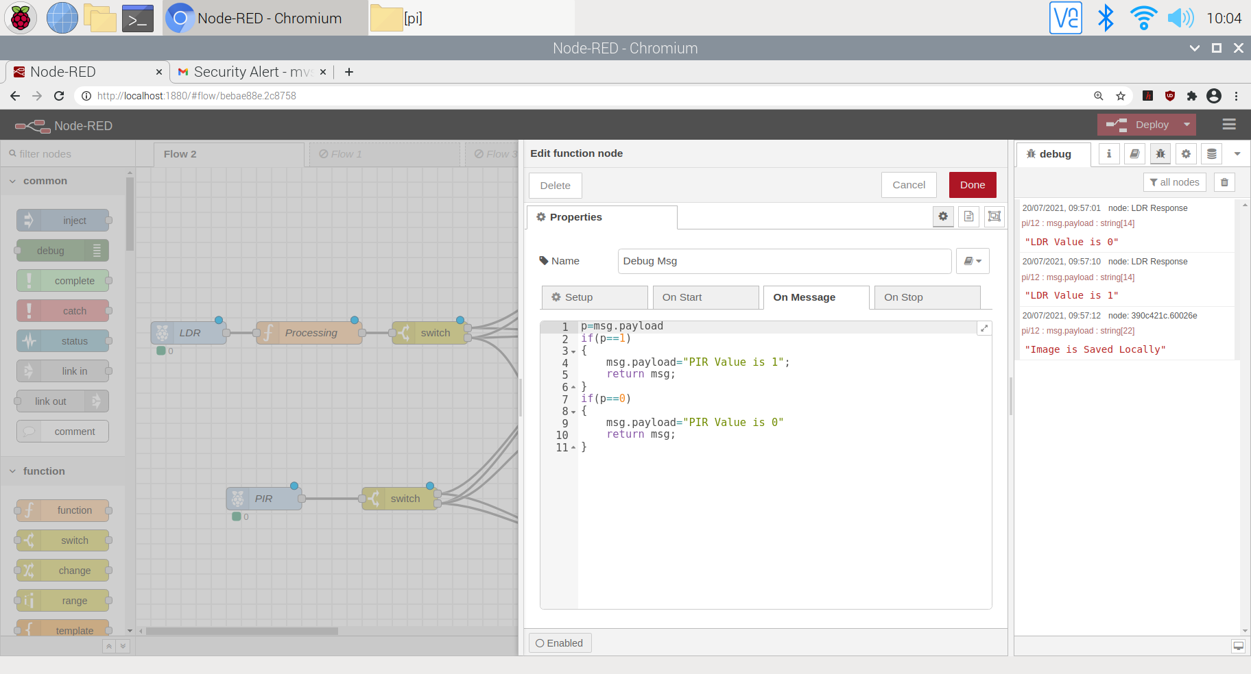
DEBUG MESSAGES

Slide 25
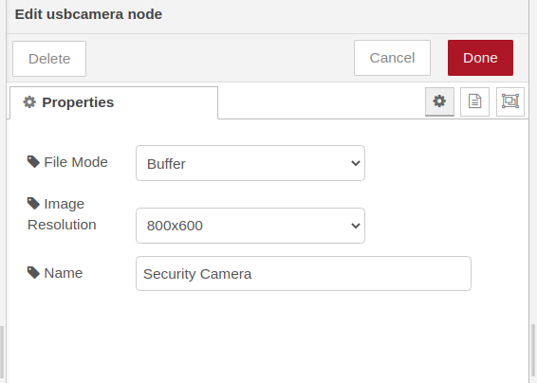
USB CAMERA NODE
USB CAMERA MODES
BUFFER
FILE MODE
GENERATE

Slide 26
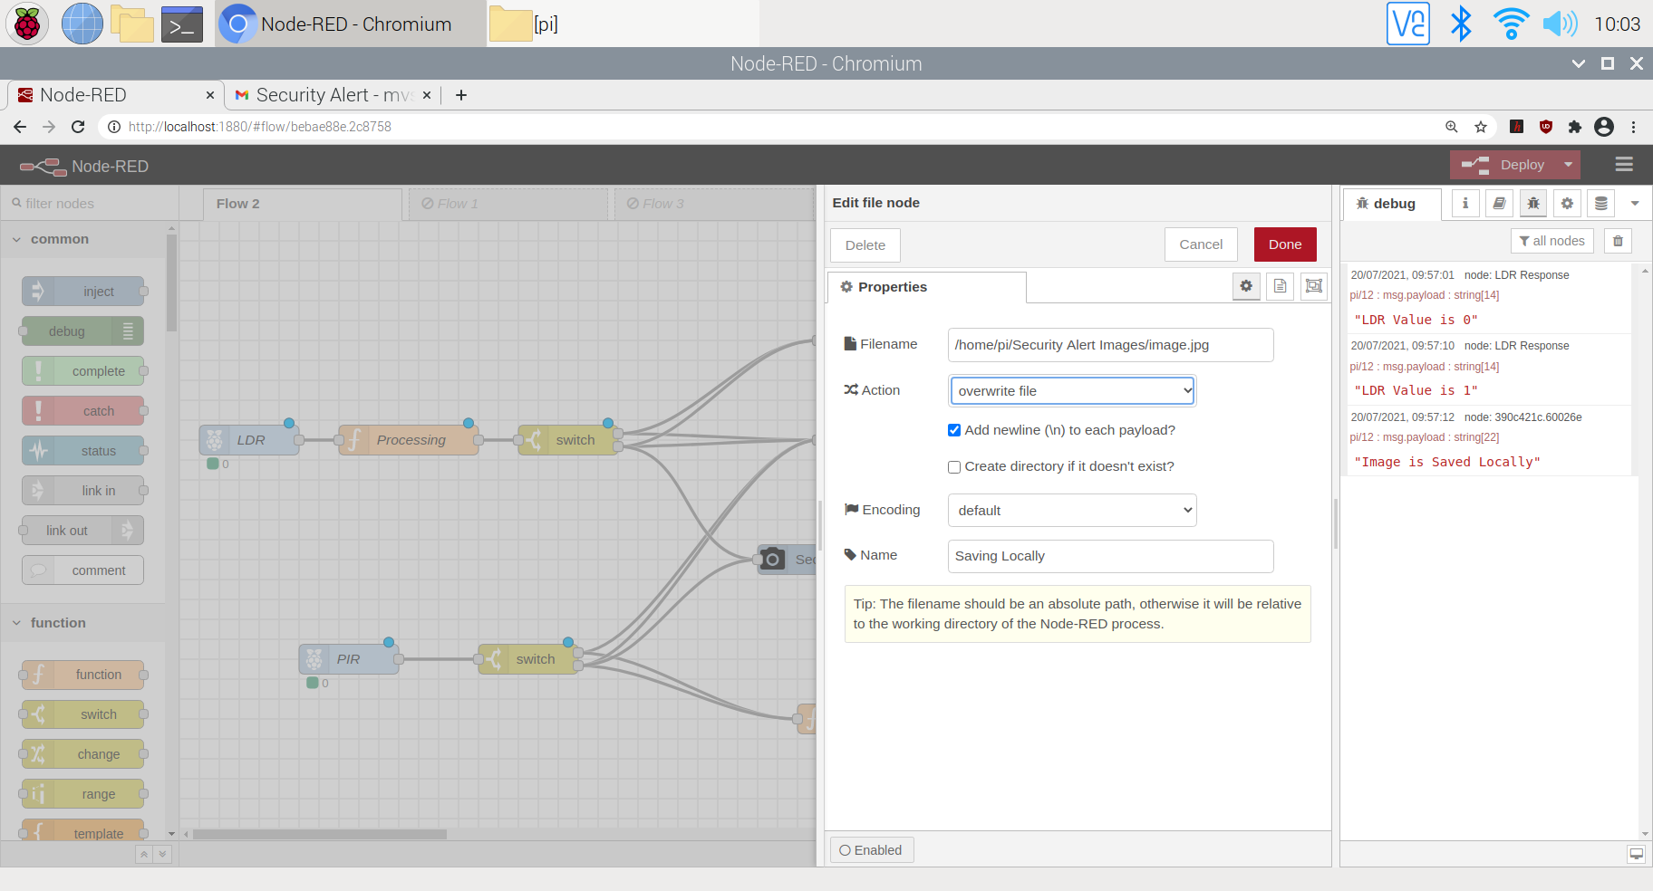
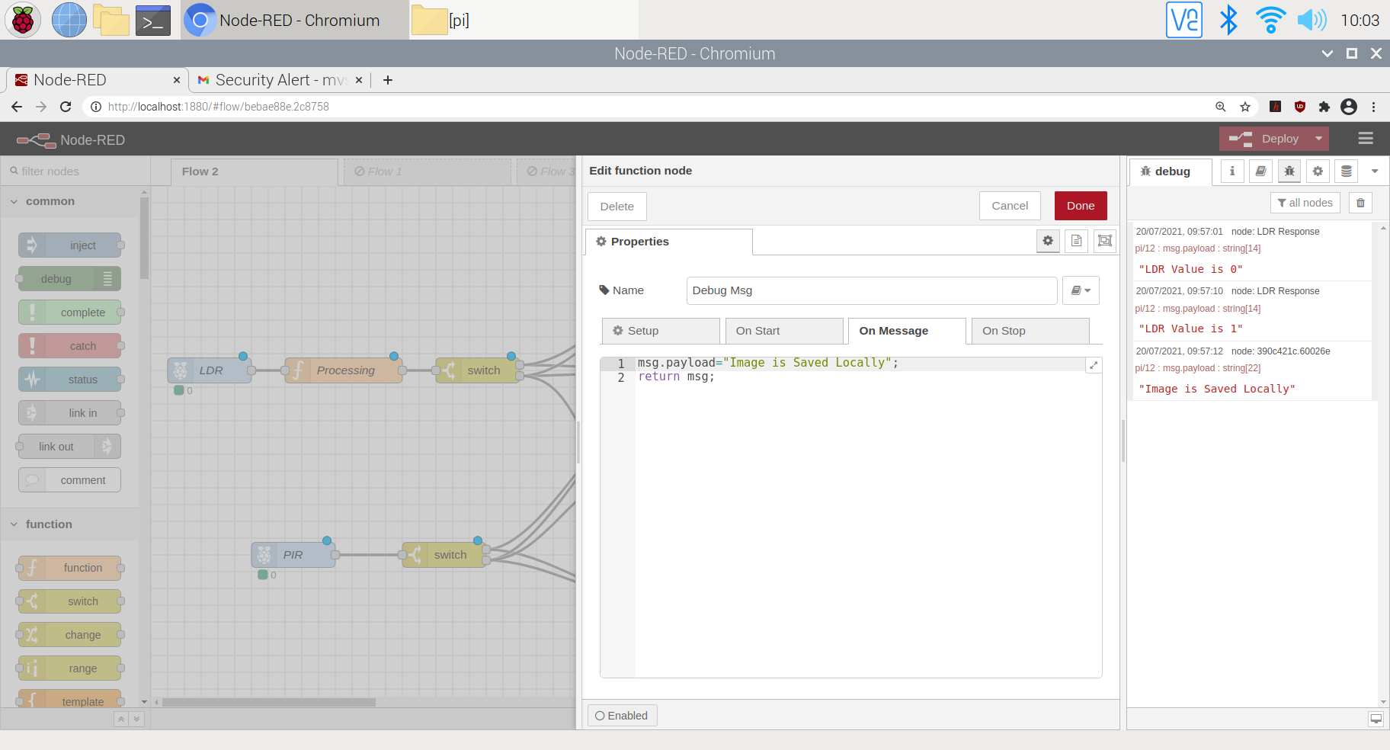
SAVING CAPTURED IMAGE LOCALLY
FILE NODE
DEBUG MESSAGE

Slide 27
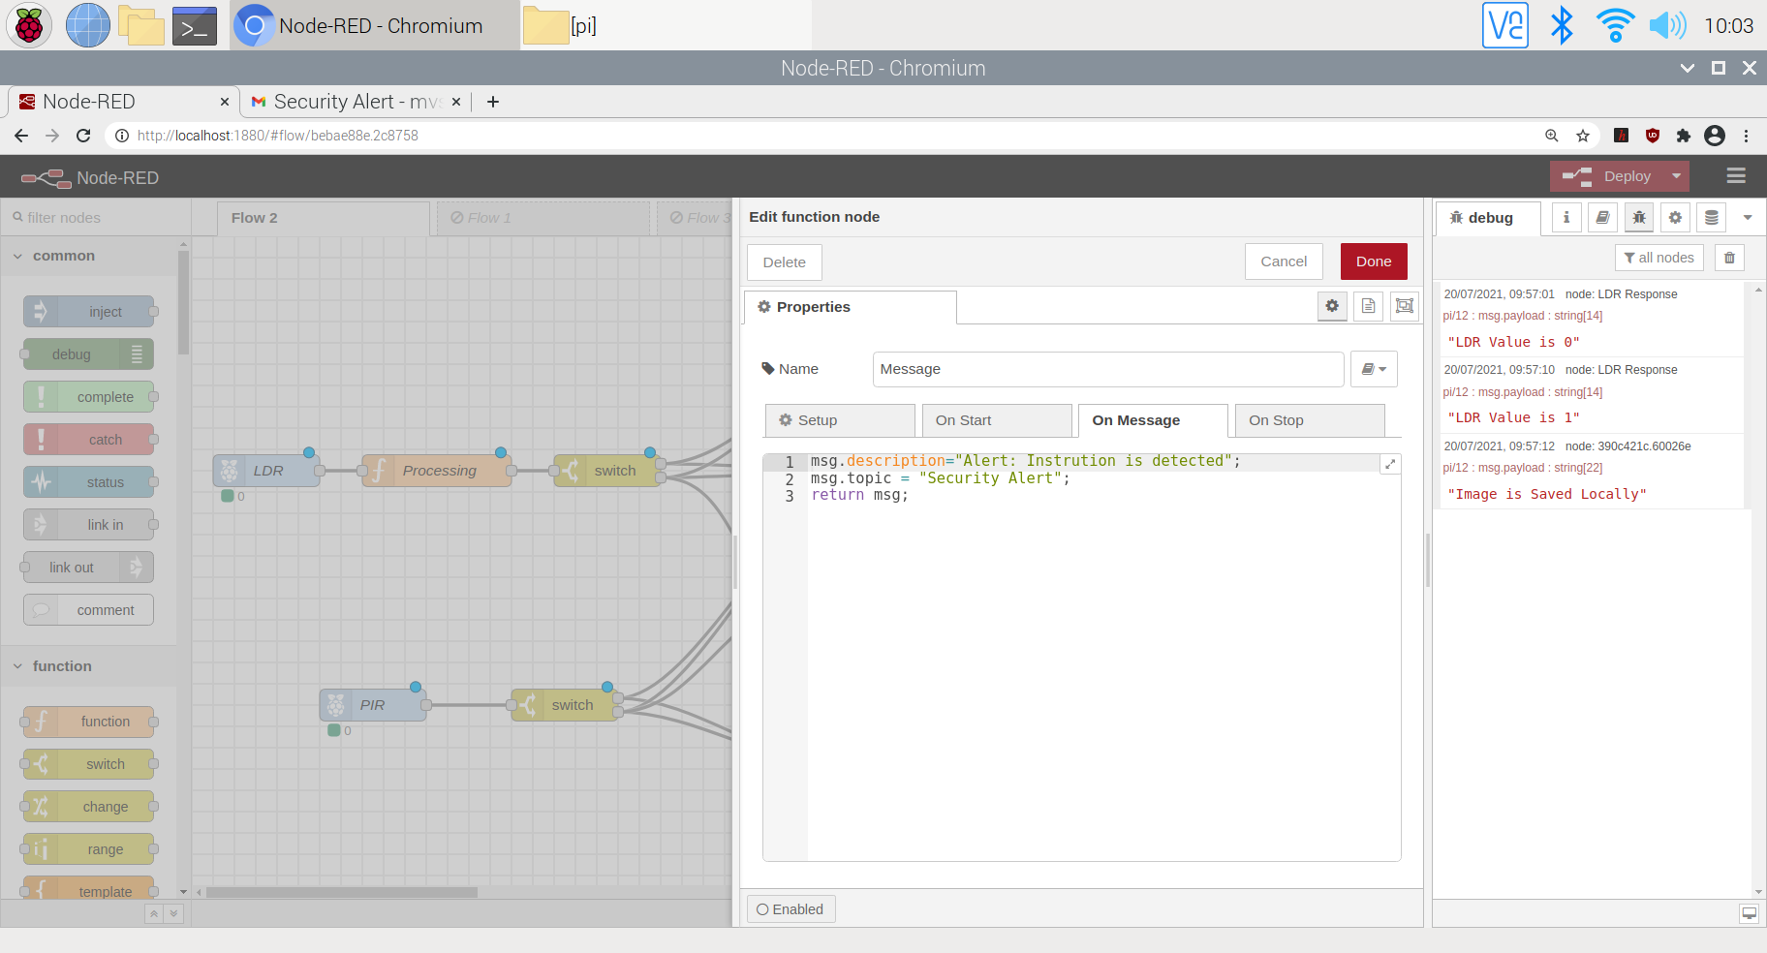
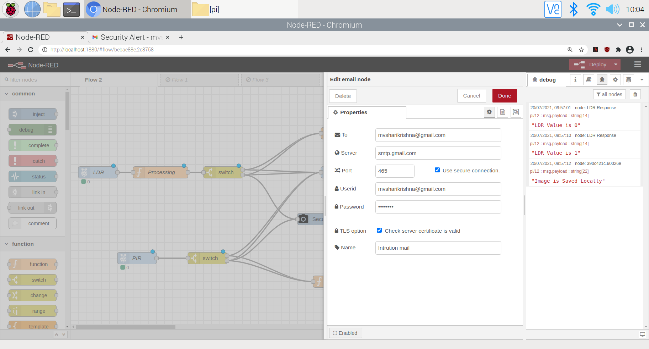
MAILING IMAGE TO USER
MAIL DESCRIPTION
MAIL NODE

Slide 28
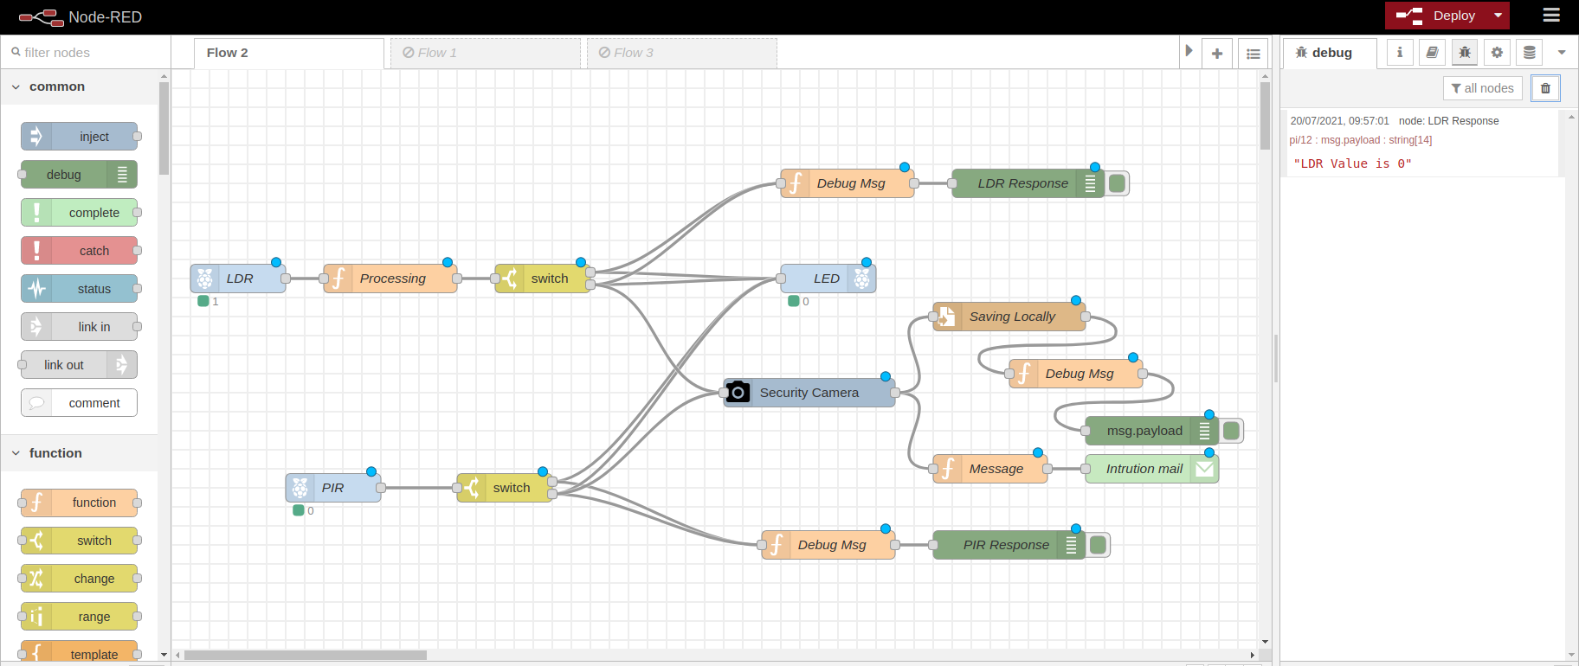
RESULT
Output when LDR = 1 & PIR = 0

Slide 29


Output When LDR = 0 or PIR = 1
Capturing image
Mailing Image

Slide 30

Output When LDR = 0 or PIR = 1

Slide 31
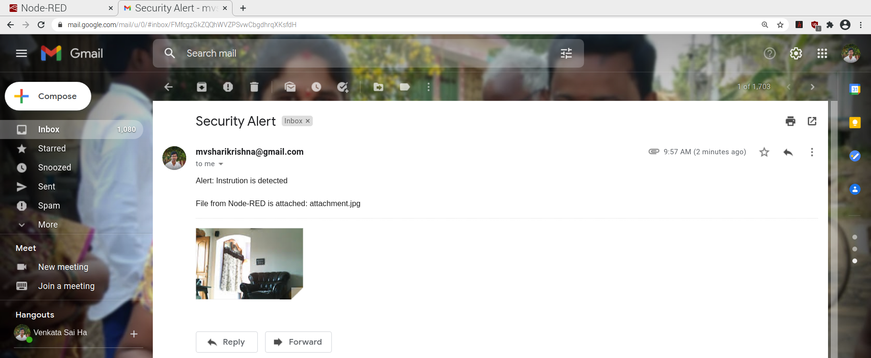
MAIL

Slide 32
ADVANTAGES
Stores the interrupter image locally also in case mail is not sent.
Realistic and easily adaptable.
Moderate Cost.
Provides High Security to Home.
Low maintenance

Slide 33
DISADVANTAGES
No Cloud Storage.
It rings alarm though if user interrupted LDR.
It does not have User identification Capability.

Slide 34
APPLICATIONS
This system be used in
Banks
Offices
Military Security Bases
Privacy Areas
Commercial Shops

Slide 35
FUTURE SCOPE
We can make this system more secure by applying encryption and decryption algorithm on data.
We can even send alerts to 100 automatically when there is an intrusion.
We can use several web-cam’s to capture the image from different angles.
We can save images in cloud.
We can add OpenCV module and add some Artificial Intelligence.

Slide 36
REFERENCES
https://iotasmarterplanet.wordpress.com/2016/05/05/home-intrusion-detection-system/
http://nodered.org/docs/hardware/raspberrypi.html
https://www.raspberrypi.org/documentation/usage/webcams/
http://www.rs-online.com/designspark/electronics/eng/blog/home-automation-with-raspberry-pi-2-and-node-red
https://www.youtube.com/watch?v=rokLM4ZsMJQ&t=525s
https://www.youtube.com/watch?v=2FgPskh7VnU

Slide 37
QUERIES PLEASE…?

Slide 38


